Slide 1

Examination System Power BI Track
Under Supervisor: Alyaa Khaled

Slide 2
Team Member
Khaled Atef
Fatama Ezzat
Saad Mahmoud
Omar Sanosy
Khadija Abdelrazeq
Heba Ibrahim

Slide 3
Agenda
What is Our Dataset
How Data is used
What is our insight
What Our Business
Database
Procedures
Dashboards
ERD

Slide 4
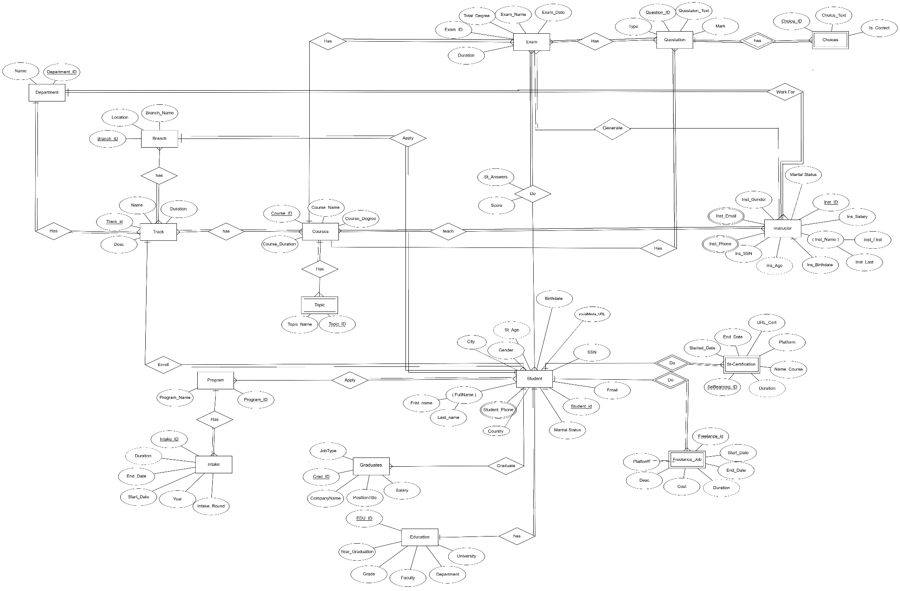
1
ERD

Slide 5
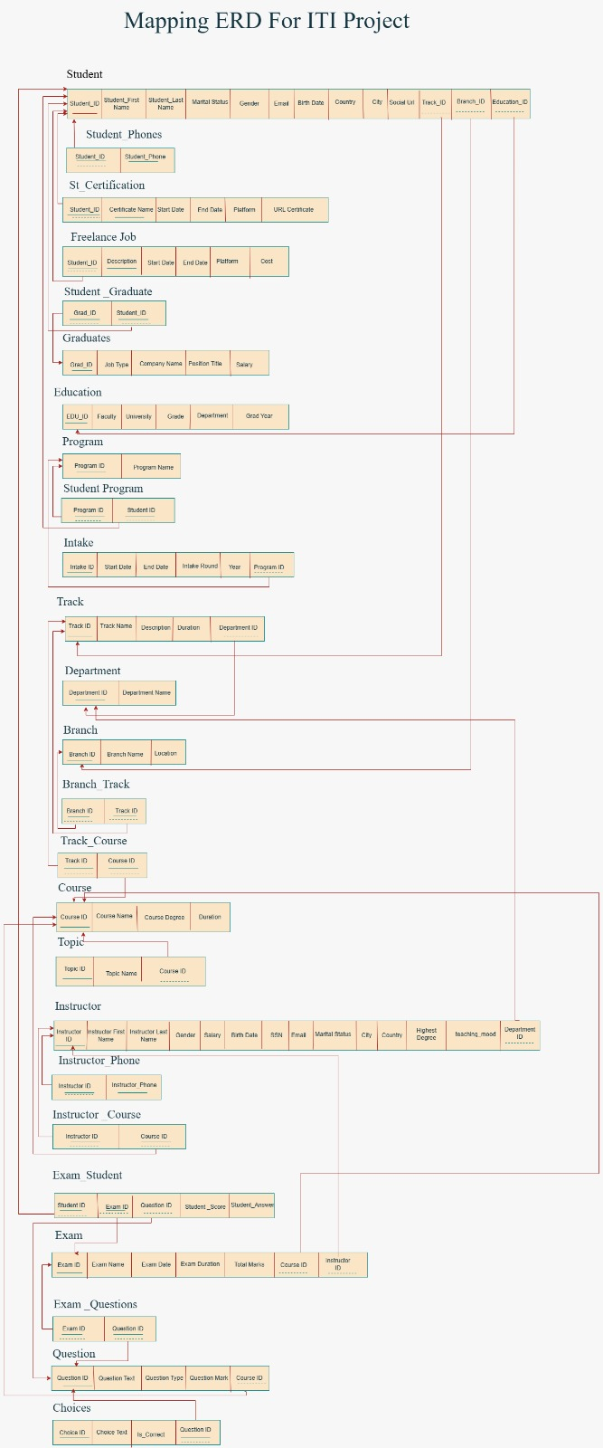
2
Mapping

Slide 6
How we Generate the Dataset ?
5
Generation Dataset
By Coding
We used python to create dataset
By AI
We generated a logic dataset

Slide 7
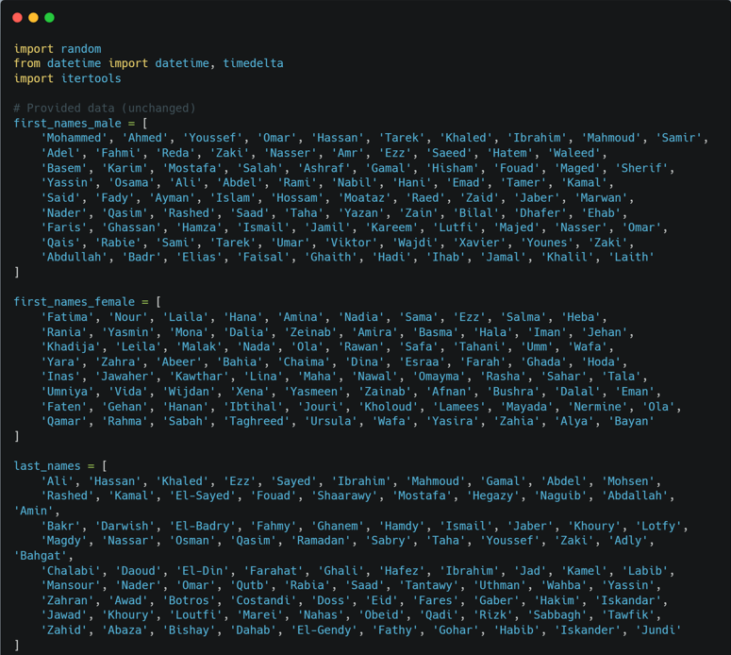
5
Generation Dataset

Slide 8
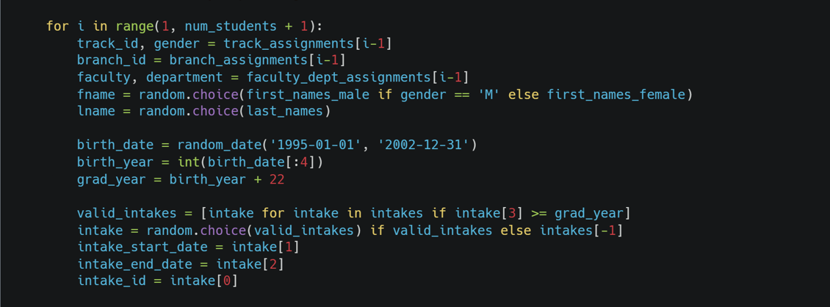
5
Generation Dataset

Slide 9
5
Generation Dataset

Slide 10
6
Procedure
Generate Exam
Student Answers
Generate Exam and select random Question
Enter Answer by specific
student
Correct Exam
Insert,update,delete
Compares student Answers, calculates the final score
In all tables in our datebase

Slide 11
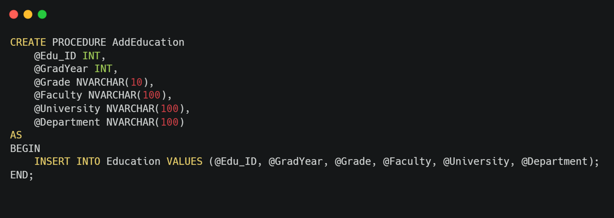
6
Procedure

Slide 12
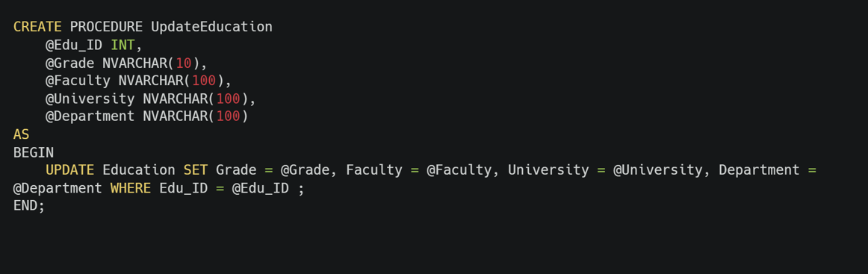
6
Procedure

Slide 13
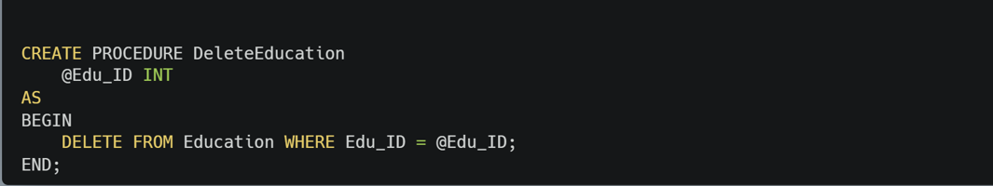
6
Procedure

Slide 14
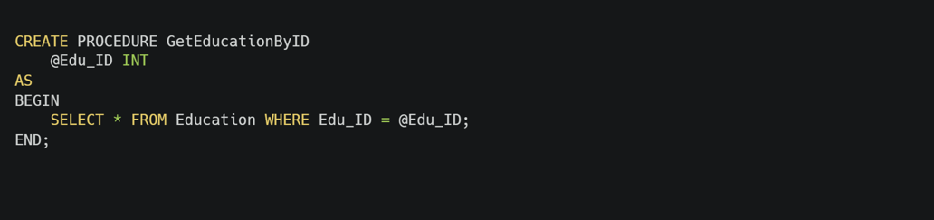
6
Procedure

Slide 15
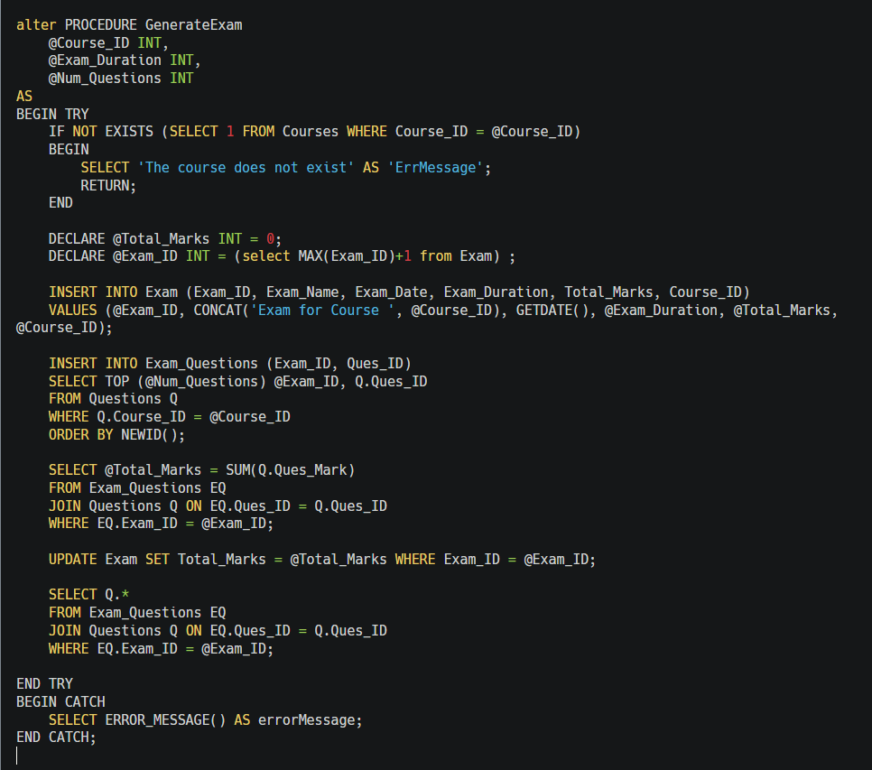
6
Procedure

Slide 16
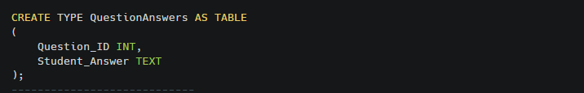
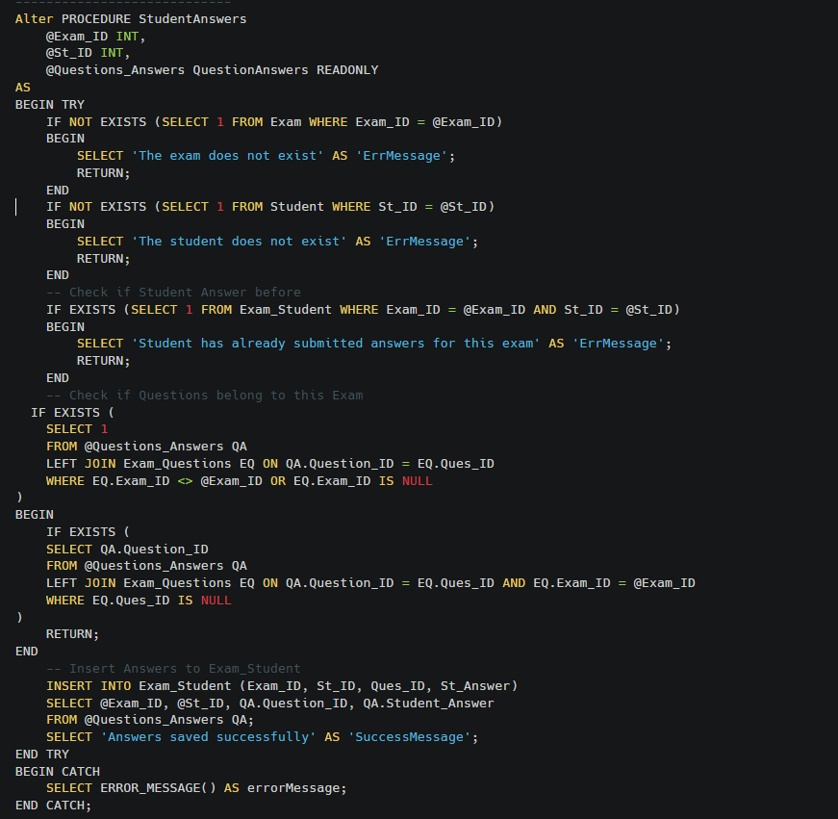
6
Procedure

Slide 17
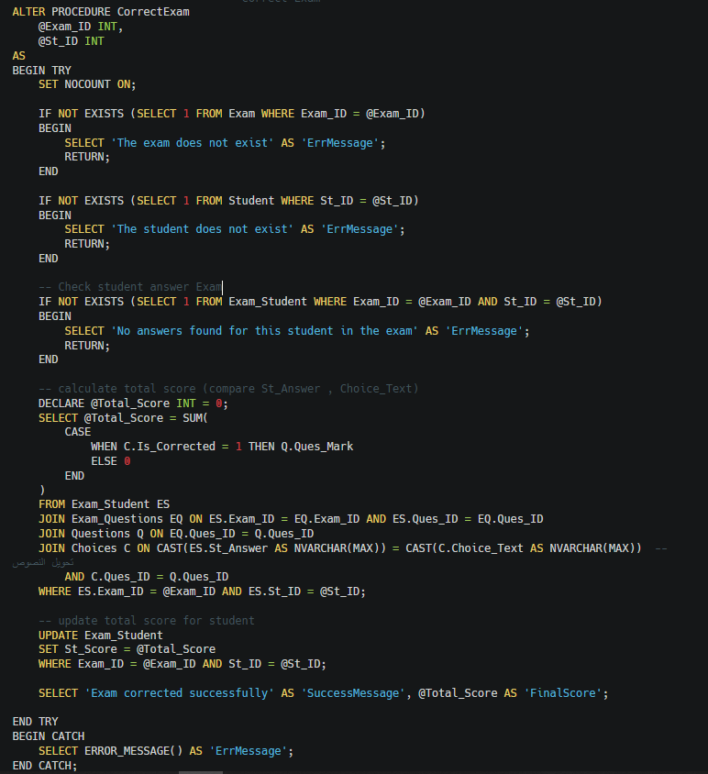
6
Procedure

Slide 18
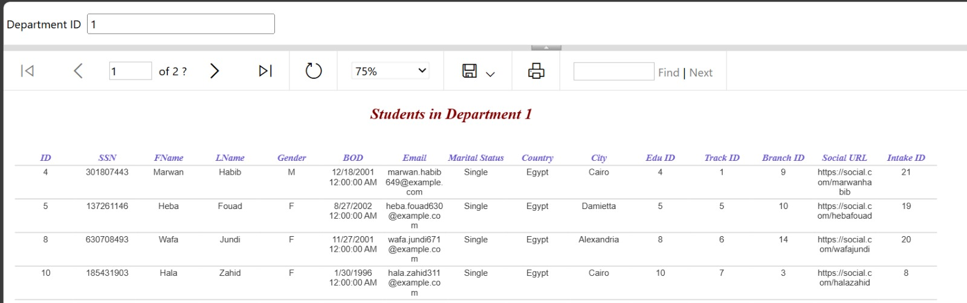
7
Reports
Returns the Student Information according to Department ID parameter.

Slide 19
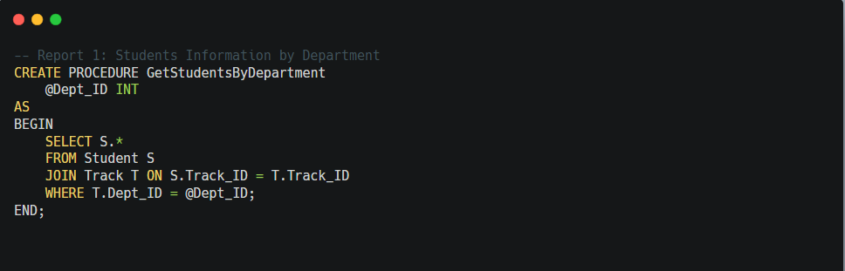
7
Reports

Slide 20
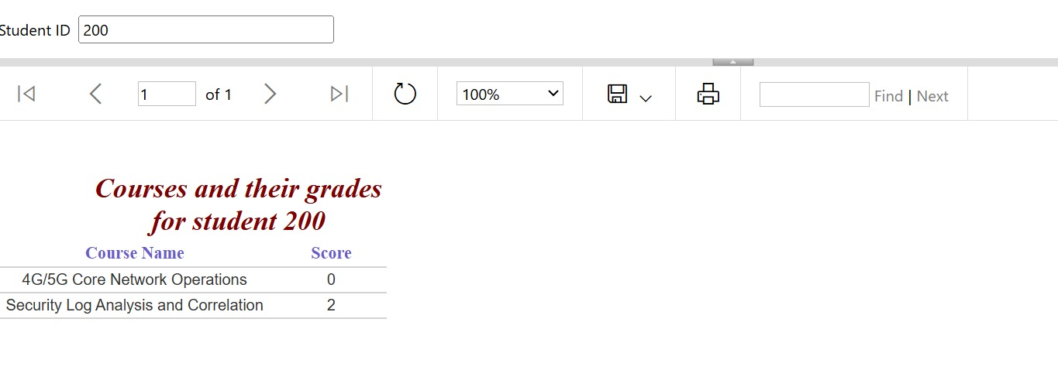
7
Reports
Takes the Student ID and returns
the Courses Name and mark in Exam

Slide 21
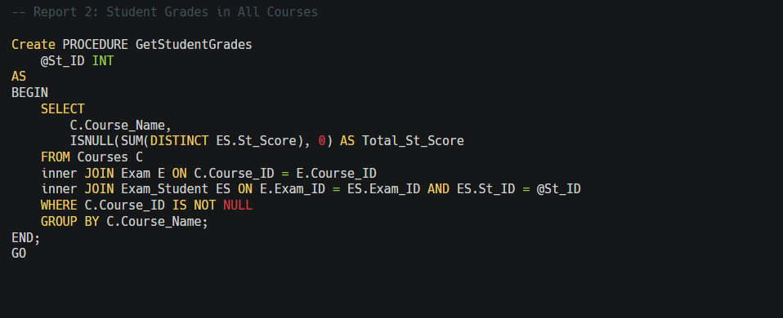
7
Reports

Slide 22
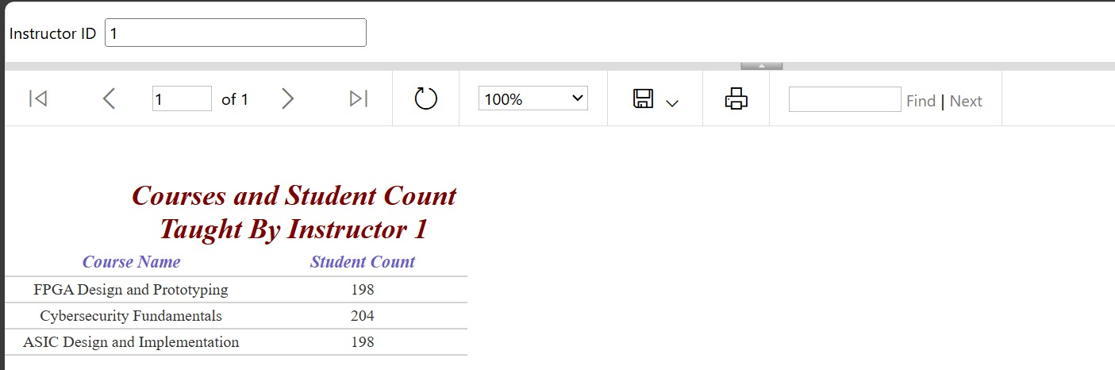
7
Reports
Takes the instructor ID and returns
the name of the courses that he teaches
and the number of student per course.

Slide 23
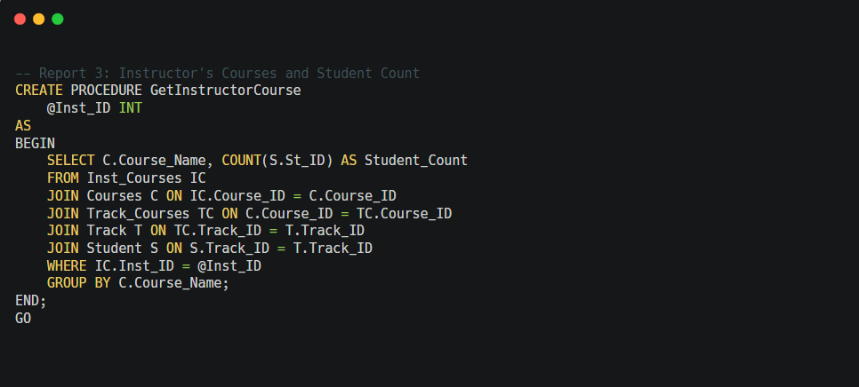
7
Reports

Slide 24
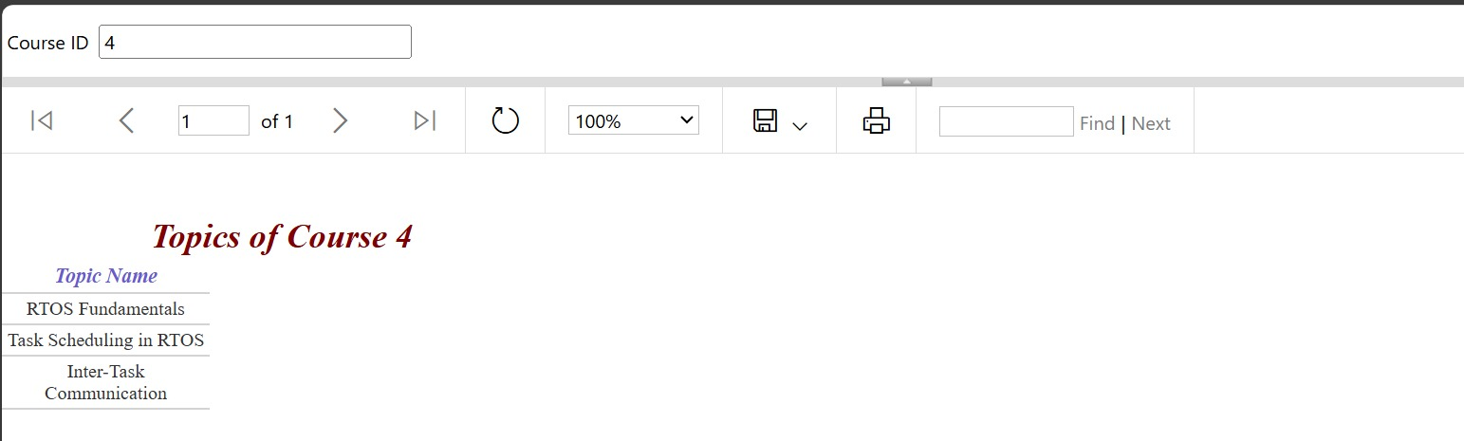
7
Reports
Takes course ID and returns its topics.

Slide 25
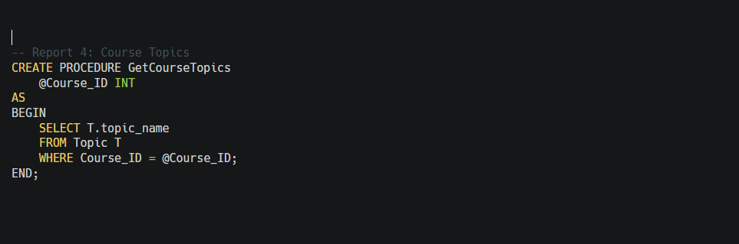
7
Reports

Slide 26
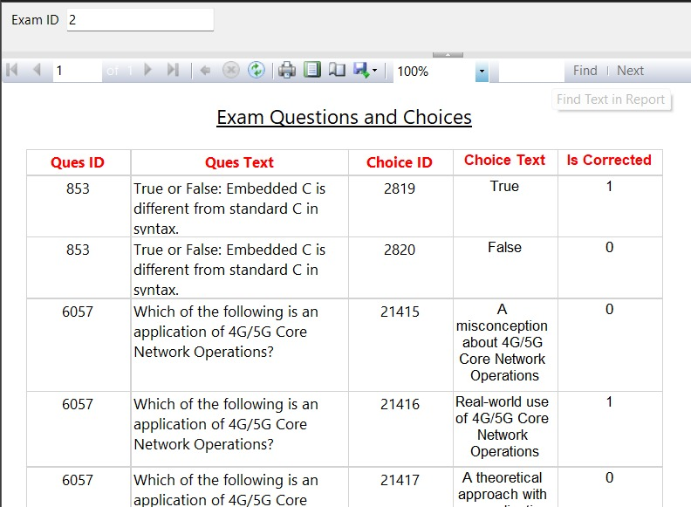
7
Reports
Takes exam number and returns the Questions in it and choices.

Slide 27
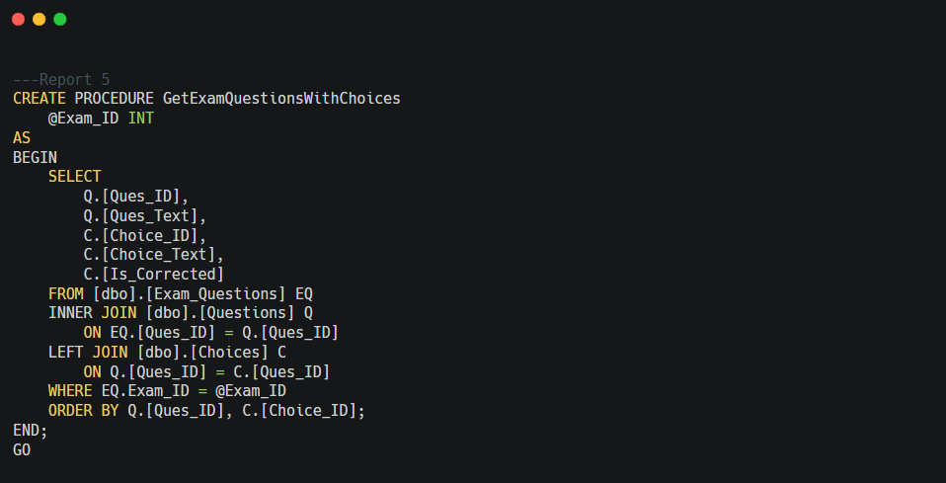
7
Reports

Slide 28
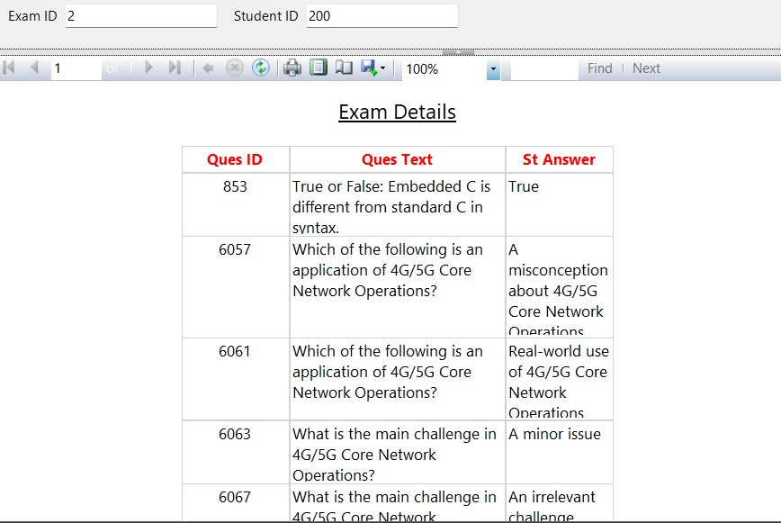
7
Reports
Takes exam ID and the student ID then
returns the Questions in this exam with the student answers.

Slide 29
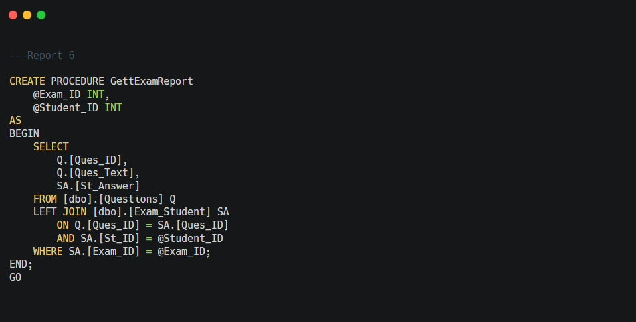
7
Reports

Slide 30

8
Dashboard

Slide 31
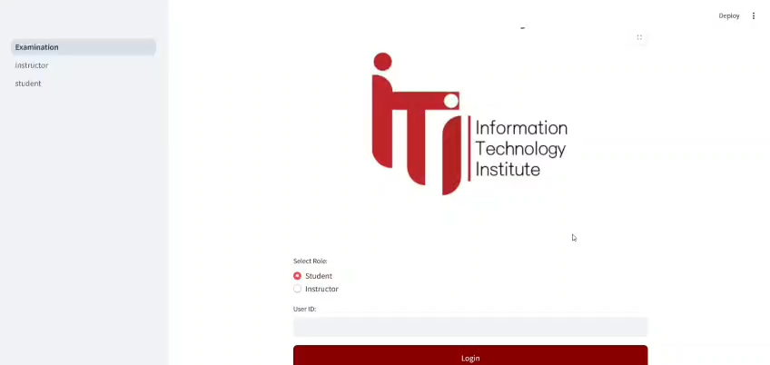
9
Website Demo

Slide 32
Thank You

